Slide 1
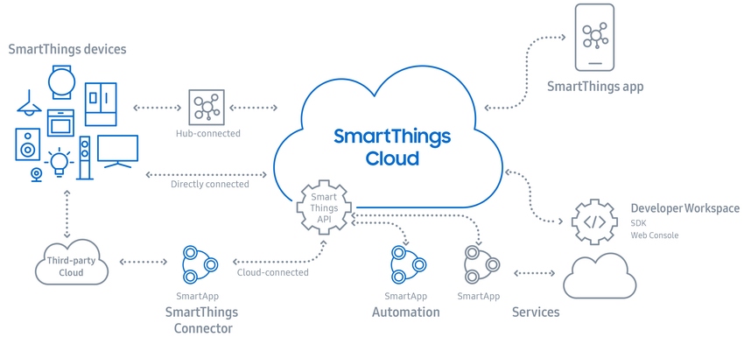
SmartThings

Slide 2
More smart devices, one smart app
Connect, automate, and manage all your Samsung and SmartThings-compatible appliances and electronics with a single, easy-to-use app.
Because smart should be simple, however many devices you bring home

Slide 3
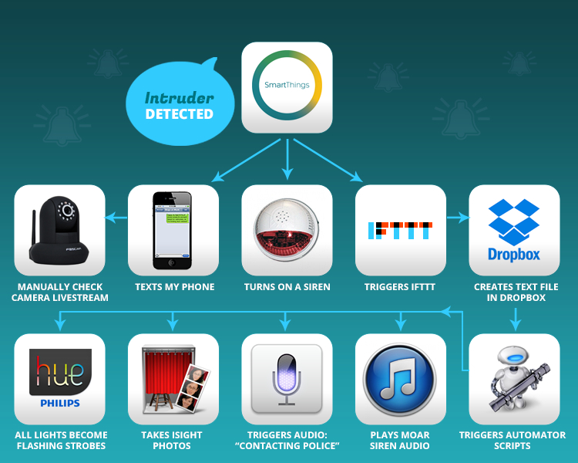
SmartThings

Slide 4
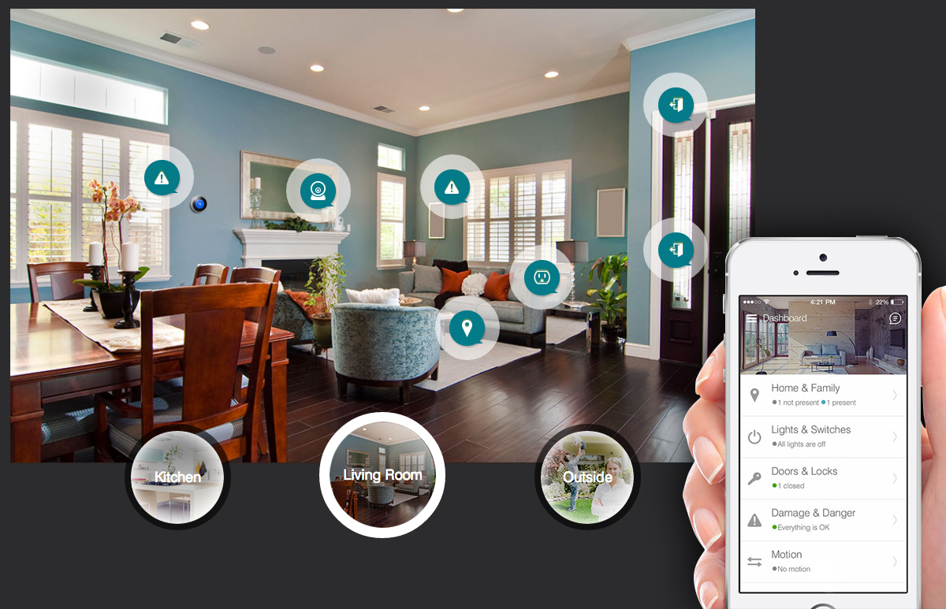
Connect a whole house of devices
SmartThings works with a growing number of devices. Just look for the "Works with SmartThings" label.

Slide 5
One app, multiple screens

